Slide 1



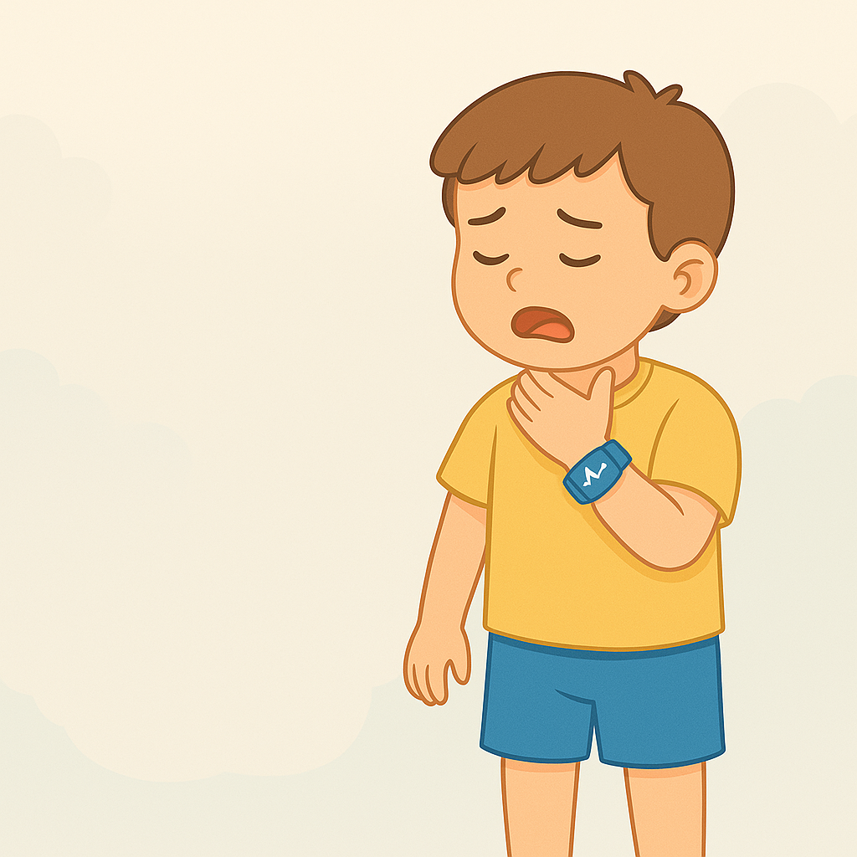
Early detection and prevention of choking in children
(kidsafe breath(
Mohammed Turki Alanazi
Emad Suliman Albalawi
Ali Abdulhkim Khalefeh
Abdelrahman Haroun Sam
Supervised By
Prof. Mohammed Alotaibi

Slide 2
introduction
Choking poses a serious risk to children under the age of three, especially when symptoms are not immediately visible. Early detection is critical for preventing life-threatening situations. This project, KIDSAFE BREATH, introduces a smart bracelet that continuously monitors vital signs mainly oxygen levels and heart rate and sends real-time alerts to caregivers.The goal is to ensure timely intervention and enhance child safety.

Slide 3



Problem Overview
Difficulty in Early Detection
Choking signs are not always visible in their initial stages.
Lack of Continuous Supervision
Children cannot be watched every moment, especially during sleep or play.
Delayed Emergency Response
Without immediate alerts, intervention may come too late.

Slide 4

AIMS AND OBJECTIVES
Develop a smart bracelet that monitors heart rate, oxygen saturation, and body temperature.
Detect abnormal vital signs that may indicate choking.
Instantly alert caregivers through a mobile application.
Provide a clear, real-time health interface for caregivers.

Slide 5
RELATED WORKS

Slide 6
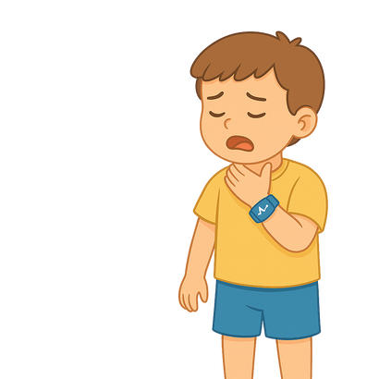
SleepU™
ADVANTAGES
DISADVANTAGES
Continuous monitoring
ALERT SYSTEMS
Data analysis
Comfortable design
Battery life
Accuracy
COST
Limited to SpO2

Slide 7
KidsO2™
ADVANTAGES
DISADVANTAGES
Continuous monitoring
Real-time alerts
Compact and comfortable
Ideal for children with health conditions
Battery life
Limited to children 3-10 years old
COST
Requires smartphone connectivity
May not be suitable for all children
May not detect all respiratory issues

Slide 8


Works related comparisons
 |  | SleepU
Feature
kidsO2
Basic Oxygen Monitoring
Sleep Pattern Monitoring
Low Oxygen Alert
Smartphone Connectivity

Slide 9
Functional Requirements
Continuously measures oxygen levels and pulse.
Transfers collected information to the server for analysis.
Detects emergencies and triggers immediate alerts when necessary.
Sends real-time alerts to parents through the mobile application

Slide 10
Non-Functional Requirements
Usability
Simple interface for non-technical parents.
Performance
Rapid data processing to ensure immediate alerts.
Scalability
Support multiple users and devices without performance degradation.
Reliability
Accurate monitoring with reduced false alarms.
Security
Encryption of health data to protect privacy.
Wearability
Lightweight and comfortable wristband for extended wear.

Slide 11

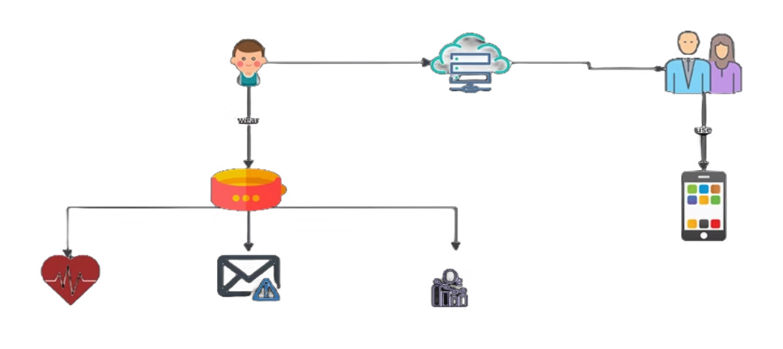


System Architecture
Child Wristband
Measures oxygen levels and heart rate.
Cloud Server
Processes and analyzes data to detect emergencies.
Parent's App
Displays real-time data and alerts.

Slide 12
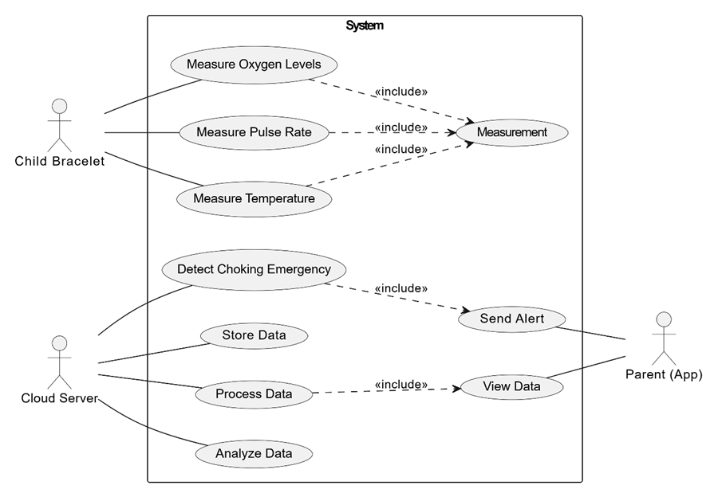
Use Case Diagram

Slide 13
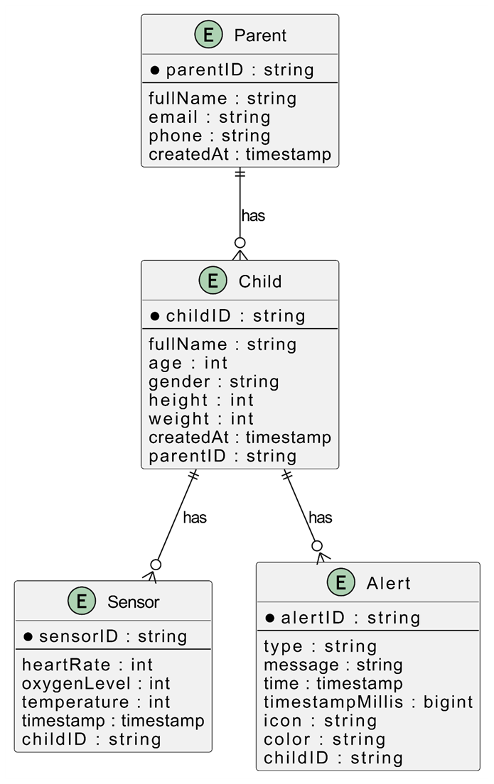
Entity Relationship Diagrams

Slide 14
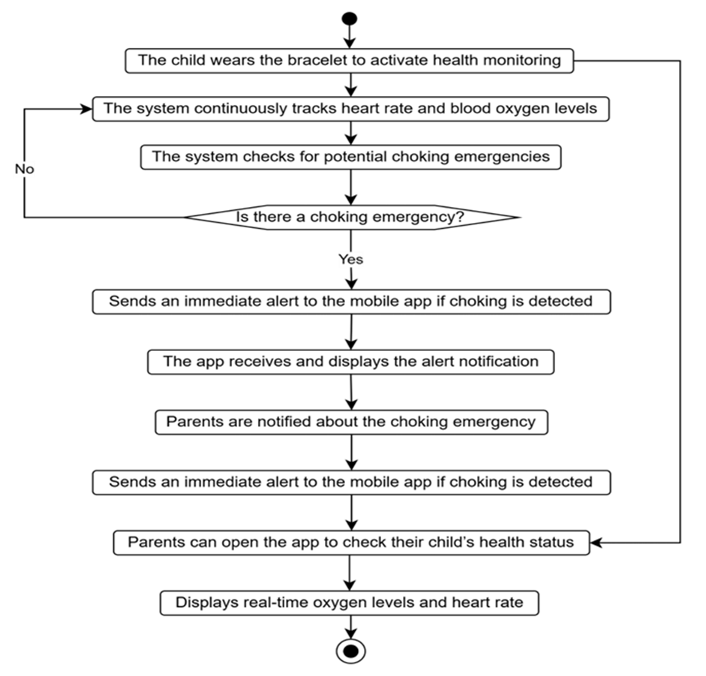
activity Diagram

Slide 15
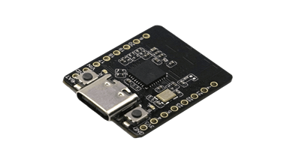
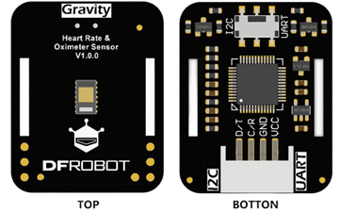
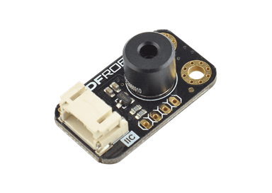
Hardware Components
ESP32-C6 MICROCONTROLLER
Max30102 Heart Rate and Oximeter Sensor
Mlx90614 Temperature Sensor

Slide 16
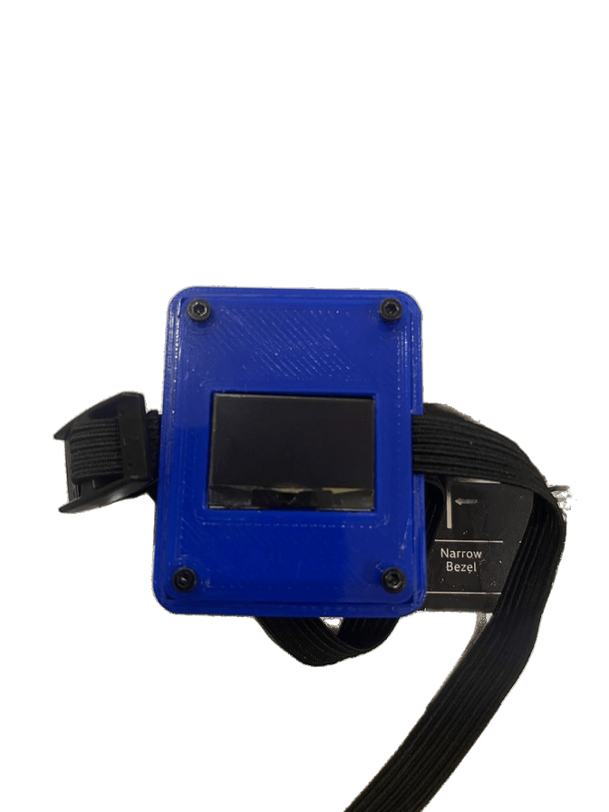
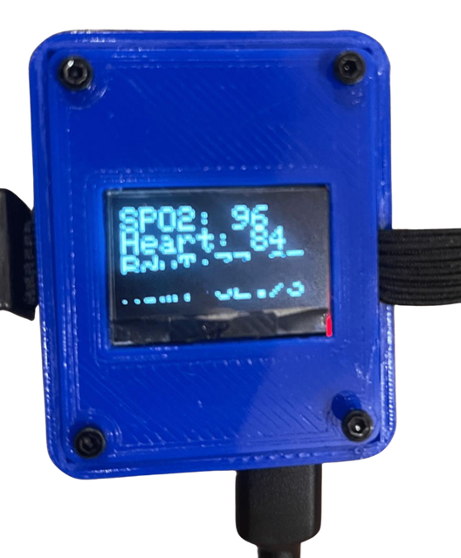
Bracelet design

Slide 17

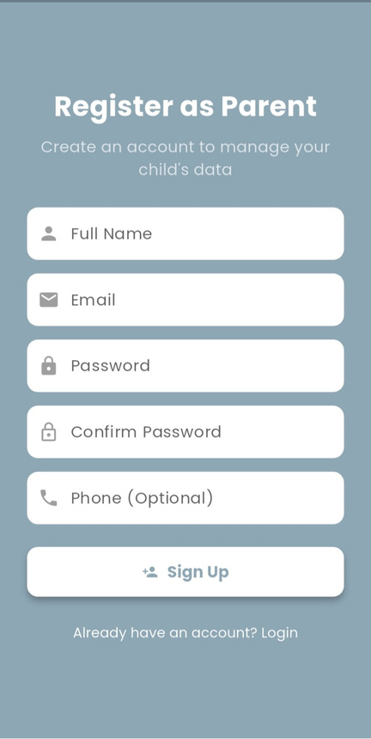
interfaces

Slide 18

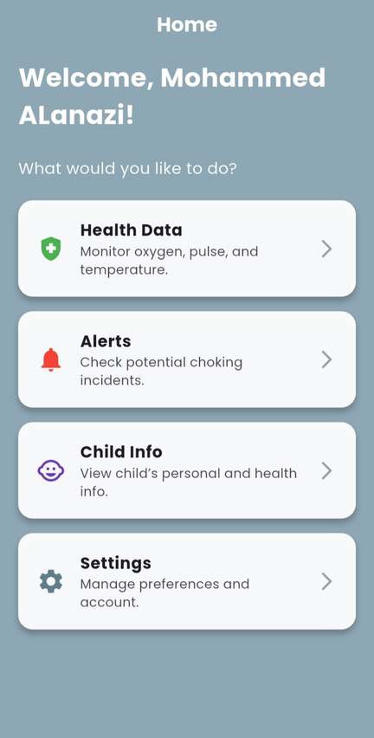
interfaces

Slide 19
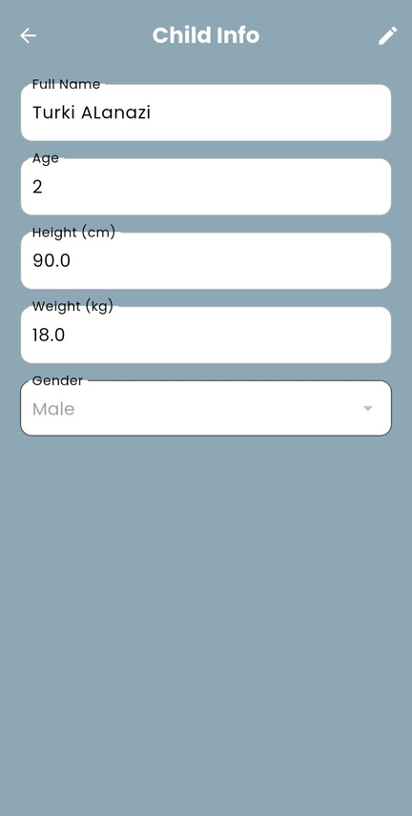
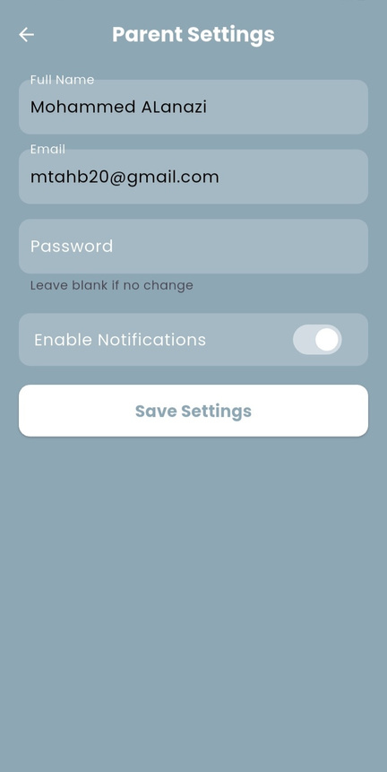
interfaces

Slide 20
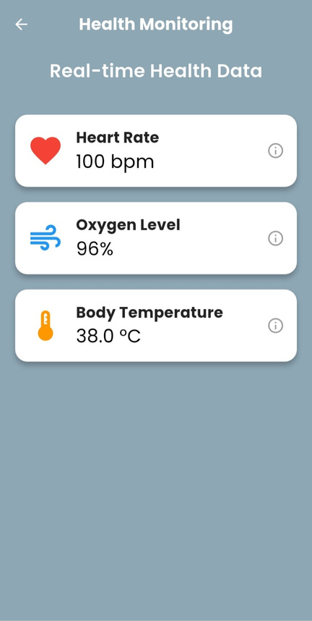

interfaces

Slide 21
Conclusion
This project aims to enhance child safety through a technical system that monitors vital signs and sends instant alerts in case of danger.
The prototype, which combines a wearable bracelet with a mobile application, has shown strong potential for future development and real-world implementation.

Slide 22
recommendations for Future Work
Enhance the hardware design to be more durable, water-resistant, and comfortable for children.
Integrate AI to detect early signs of health risks such as choking.
Provide a cloud dashboard for medical professionals to monitor children remotely.
Support monitoring multiple children under a single parent account.
Add health history charts and visual trends for better data tracking.

Slide 23
thank you!

